Slide 1
Chapter 12
Stoichiometry
SCSh5.e: Solve scientific problems by substituting quantitative values, using dimensional analysis and/or simple algebraic formulas as appropriate.
SC2.d: Identify and solve different types of stoichiometry problems, specifically relating mass to moles and mass to mass.
SC2.e: Demonstrate the conceptual principle of limiting reactants.
Online Resources:
Stoichiometry Practice Problems: http://mailer.fsu.edu/~rlight/stoich/
Click Stoichiomentry: http://misterguch.brinkster.net/explains2.html

Slide 2
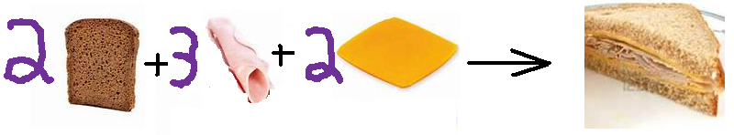
Stoichiometry
A balanced chemical equation provides the same kind of quantitative information that a recipe does.
Chemists use balanced chemical equations as a basis to calculate how much reactant is needed or product is formed in a reaction.

Slide 3
Stoichiometry
Stoichiometry is the calculation of quantities in chemical reactions.
When you know the quantity of one substance in a reaction, you can calculate the quantity of another substance consumed or created in the reaction.
A quantity can be grams, moles, liters, molecules, atoms, ions, formula units or particles.

Slide 4
Stoichiometry
A balanced equation indicates the number and type of each atom, molecules, and/or moles that makes up each reactant and each product
A balanced chemical equation obeys the law of conservation of mass
  The total number of grams of reactants DOES equal the total number of grams of product
Assuming standard temperature and pressure, a balanced equation also tells you about the volume of gases.
Mass and atoms are conserved in every chemical reaction

Slide 5
Stoichiometry
Mole ratio is a conversion factor derived from coefficients of a balanced chemical equation interpreted in terms of moles.
In chemical calculations, mole ratios are used to convert between
  moles of reactants and moles of product,
  or moles of products and moles of reactants
  or between moles of two products, or two reactants
In the mole ratio you MUST use the COEFFICIENTS of the BALANCED chemical reaction

Slide 6
Mole to Mole Conversion
In order to do stoichiometry conversions you MUST have a balanced chemical reaction.
Use our basic dimensional analysis set up…
  Unit getting rid of on bottom, unit going to on top
  NOT just the units, it is ALSO the chemical formulas
Example 1: If you decompose 6.50 moles of ammonia (NH3) how many moles of each product do you produce?
Skeleton equation: NH₃ → N₂ + H₂
Balanced equation: 2NH₃ → 1 N₂ + 3 H₂

Slide 7
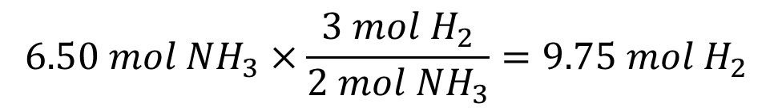
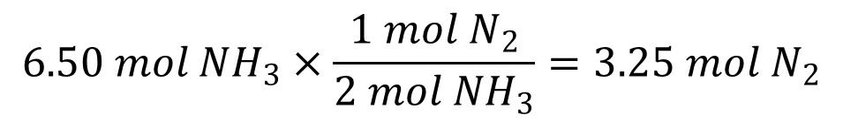
Mole to Mole Conversion
Example 1: If you decompose 6.50 moles of ammonia (NH₃) how many moles of each product do you produce?
Balanced equation: 2NH₃ → 1 N₂ + 3 H₂
$$6.50 mol {NH}_{3}×\frac{1 mol N_{2}}{2 mol {NH}_{3}}=3.25 mol N_{2}$$
$$6.50 mol {NH}_{3}×\frac{3 mol H_{2}}{2 mol {NH}_{3}}=9.75 mol H_{2}$$

Slide 8
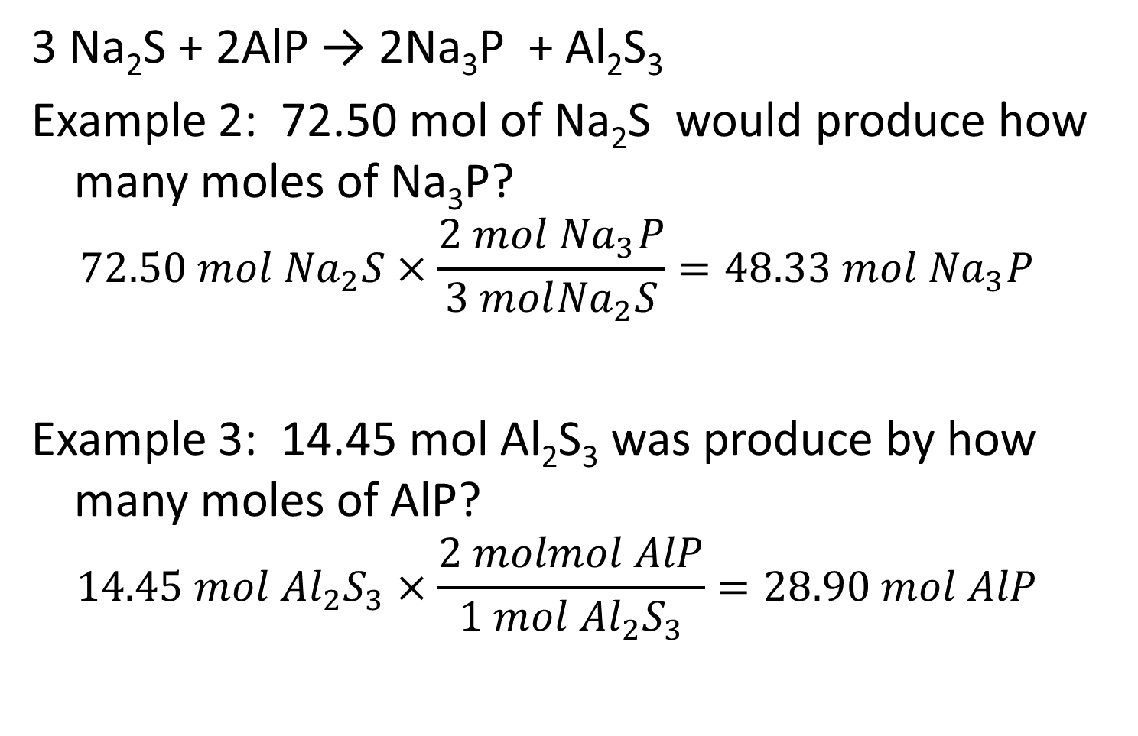
Mole to Mole Conversion
3 Na₂S + 2AlP → 2Na₃P + Al₂S₃
Example 2: 72.50 mol of Na₂S would produce how many moles of Na₃P?
$$72.50 mol {Na}_{2}S×\frac{2 mol {Na}_{3}P}{3 mol{Na}_{2}S}=48.33 mol {Na}_{3}P$$
Example 3: 14.45 mol Al₂S₃ was produce by how many moles of AlP?
$$14.45 mol {Al}_{2}S_{3}×\frac{2 molmol AlP}{1 mol {Al}_{2}S_{3}}=28.90 mol AlP$$

Slide 9
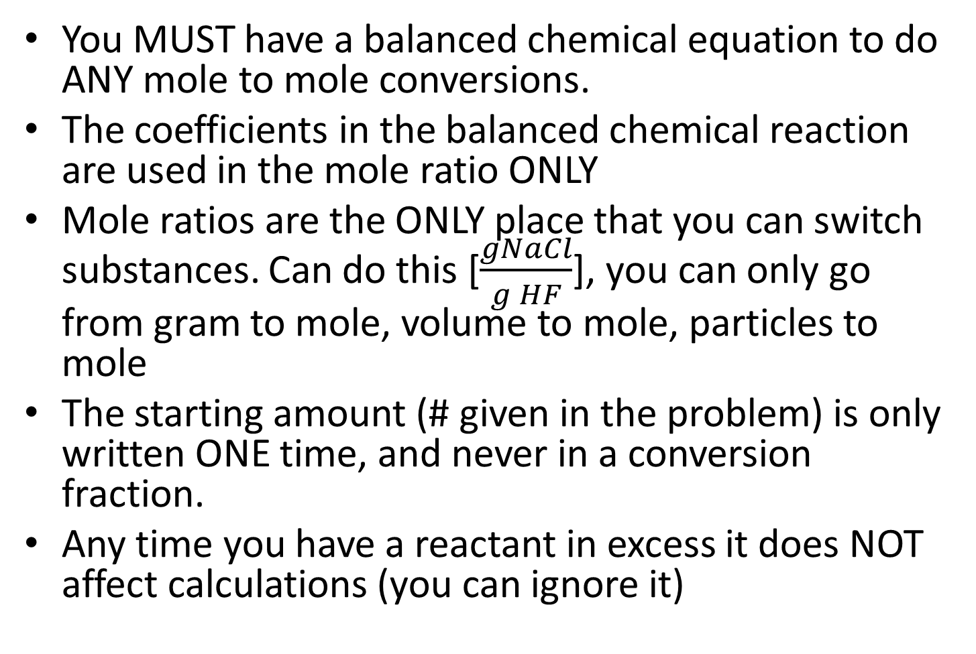
Things to remember
You MUST have a balanced chemical equation to do ANY mole to mole conversions.
The coefficients in the balanced chemical reaction are used in the mole ratio ONLY
Mole ratios are the ONLY place that you can switch substances. Can do this [$\frac{gNaCl}{g HF}$], you can only go from gram to mole, volume to mole, particles to mole
The starting amount (# given in the problem) is only written ONE time, and never in a conversion fraction.
Any time you have a reactant in excess it does NOT affect calculations (you can ignore it)

Slide 10
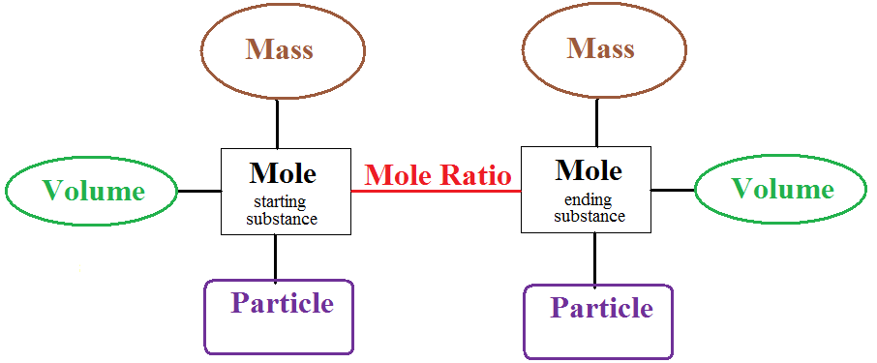
New Mole Map

Slide 11
Terminology
Theoretical yield is the maximum amount of product that will form during a reaction.
Any time you are calculating the amount of product produced you are calculating theoretical yield.
Actual yield is the amount of product that actually forms when the reaction is carried out in a laboratory.

Slide 12
Stoichiometry Calculations
the first step is to convert the give substance measurement to moles. (if not starting with moles)
Next use the mole ratio to switch between substances
Finally convert to the desired substance to the correct unit for the final answer.
Use your mole map to help determine the number of fractions needed to do conversion.

Slide 13









Mass to Mass Conversion
2NH₃ → 1 N₂ + 3 H₂
Example 1: 48.38 g NH₃ would produce how many grams of nitrogen.
Use map to lay out our path
3 bridges = 3 fractions
Example 2: 48.38 g NH₃ would produce how many grams of hydrogen

Slide 14
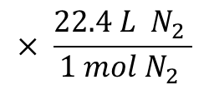



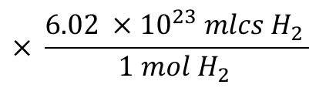
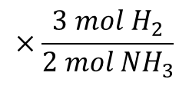

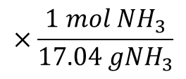
Mass to Volume Conversion
2NH₃ → 1 N₂ + 3 H₂
Example 3: 48.38 g NH₃ would produce how many liters of nitrogen.
$$\frac{1 mol N_{2}}{2 mol {NH}_{3}}$$
$$× \frac{22.4 L N_{2} }{1 mol N_{2} }$$
$$= 31.80L N_{2}$$
Example 4: If you have 68.92 g NH₃ what would the theoretical yield of hydrogen be in molecules?
$$×\frac{1 mol {NH}_{3}}{17.04 g{NH}_{3}}$$
$$×\frac{3 mol H_{2}}{2 mol {NH}_{3}}$$
$$× \frac{{6.02 ×10}^{23} mlcs H_{2} }{1 mol H_{2} }$$
$$68.92g {NH}_{3}$$
$$={3.659 ×10}^{24}mlcs H_{2}$$

Slide 15
Things to remember
UNLESS it is a mole ratio mole always has a 1 in front of it.
The numbers for the mole ratio come from the BALANCED chemical equation.
Use your mole map to see how many steps it will take
There are only 4 valid possible options.
  1 mole = (molar mass) g
  1 mole = 22.4 L
  1 mole = 6.02 x 1023 particles
  __ mole X = ____ mole Y (___ come from equation)

Slide 16
Terminology Part II
Limiting reagent is the reagent that determines the amount of product that can be formed by a reaction.
Excess reagent is the reactant that is not completely used up in a reaction.
  To determine the limiting reactant convert one reactant into grams of second reactant
  Compare the two values
    If you won’t have enough of the second reactant it is the limiting
    If you have enough of the second reactant it is the excess reagent

Slide 17
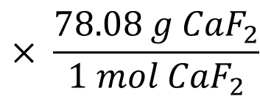
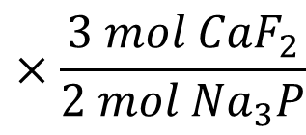
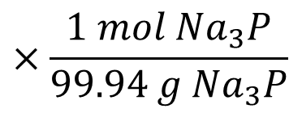


Limiting Reactant example 1
If starting with 6.25 g Na₃P and 5.88 g CaF₂ what is the limiting reactant?
__ Na₃P + __ CaF₂ → __ NaF + __ Ca₃P₂
Balanced: 2 Na₃P + 3 CaF₂ → 6 NaF + 1 Ca₃P₂
$$×\frac{1 mol {Na}_{3}P}{99.94{ g Na}_{3}P}$$
$$×\frac{3 mol {CaF}_{2}}{2 mol{ Na}_{3}P}$$
$$× \frac{78.08 g{ CaF}_{2}}{1 mol {CaF}_{2}}$$
$$6.25g {Na}_{3}P$$
$$=7.32 g{ CaF}_{2}$$
This says we NEED 7.32 g CaF₂ but we only have 5.88 g CaF₂
Since we don’t have enough of it CaF₂ is the limiting
And Na₃P is the excess reagent

Slide 18
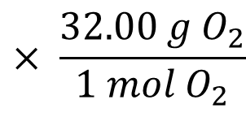
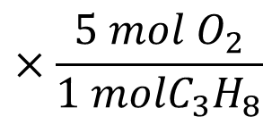
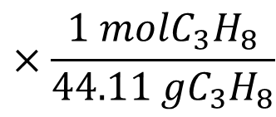


Limiting Reactant example 2
If starting with 25.0 grams of each reactant determine the limiting reagent : C₃H₈ + 5O₂ → 3CO₂ + 4H₂O
$$×\frac{1 molC_{3}H_{8}}{44.11 gC_{3}H_{8}}$$
$$×\frac{5 mol O_{2}}{1 molC_{3}H_{8}}$$
$$× \frac{32.00 g O_{2}}{1 mol O_{2}}$$
$$25.0g C_{3}H_{8}$$
$$=90.7 g O_{2}$$
We have 25.0 grams of oxygen
we need 90.7 g oxygen
Oxygen is the limiting reagent because we don’t have enough of it.
The excess reagent is the C₃H₈

Slide 19
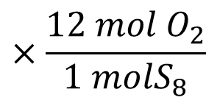
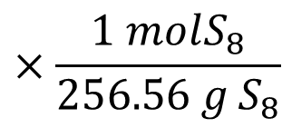


Limiting Reactant example 3
If starting with 2.50g S₈ and 3.54 g O₂ determine the limiting reagent : S₈ + 12 O₂ → 8SO₃
$$×\frac{1 molS_{8}}{256.56 g S_{8}}$$
$$×\frac{12 mol O_{2}}{1 molS_{8}}$$
$$× \frac{32.00 g O_{2}}{1 mol O_{2}}$$
$$2.50g{ S}_{8}$$
$$=3.74 g O_{2}$$
We have 3.54 grams of oxygen
we need 3.74 g oxygen
Oxygen is the limiting reagent because we don’t have enough of it.
The S₈ is the excess reagent

Slide 20
Limiting Reactant (Reagent)
Just by looking at the starting masses it is IMPOSSIBLE to determine the limiting reactant
Just by looking at the coefficients it is IMPOSSIBLE to determine the limiting reactant
You can only determine limiting reactant IF you are comparing the same COMPOUND and same UNIT.

Slide 21
Terminology Part III
Excess reagent is the reactant that is not completely used up in a reaction.
  To determine the excess remaining covert the limiting reactant to excess reactant and subtract that number from the stating amount of excess reactant.

Slide 22

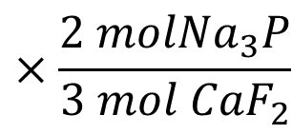
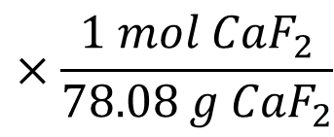


Amount of Excess Remaining
If starting with 6.25 g Na₃P and 5.88 g CaF₂. How much excess remains after reaction?
2 Na₃P + 3 CaF₂ → 6 NaF + 1 Ca₃P₂
Recall that the limiting in this reaction was the CaF₂
$$×\frac{1 mol{ CaF}_{2}}{78.08 g {CaF}_{2}}$$
$$×\frac{2 mol{Na}_{3}P}{3 mol{ CaF}_{2}}$$
$$× \frac{99.94 g{ Na}_{3}P}{1 mol{Na}_{3}P}$$
$$5.88 g {CaF}_{2}$$
$$=5.02 g {Na}_{3}P$$
We used 5.02 grams of Na₃P
Excess remaining = Starting amount – amount used
Excess Remaining = 6.25 g Na₃P – 5.02 g Na₃P = 1.23 g Na₃P

Slide 23
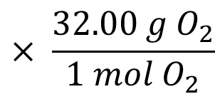
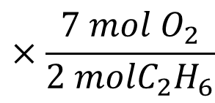
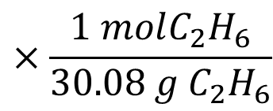


Limiting and Excess Example
If starting with 15.0g C₂H₈ and 75.0 g O₂
2 C₂H₆ + 7 O₂ → 4 CO₂ + 6 H₂O
determine the limiting reagent
the grams of excess reagent left after the reaction:
$$×\frac{1 molC_{2}H_{6}}{30.08 g C_{2}H_{6}}$$
$$×\frac{7 mol O_{2}}{2 molC_{2}H_{6}}$$
$$× \frac{32.00 g O_{2}}{1 mol O_{2}}$$
$$15.0g C_{2}H_{6}$$
We have 75.0 grams of oxygen
we need 55.85g oxygen
We have more than we need so Oxygen is the excess.
So The limiting reagent is the C₂H₆
excess remaining: 75.0 O₂ – 55.9 g O₂ = 19.1 g O₂
$$=55.9 g O_{2}$$

Slide 24
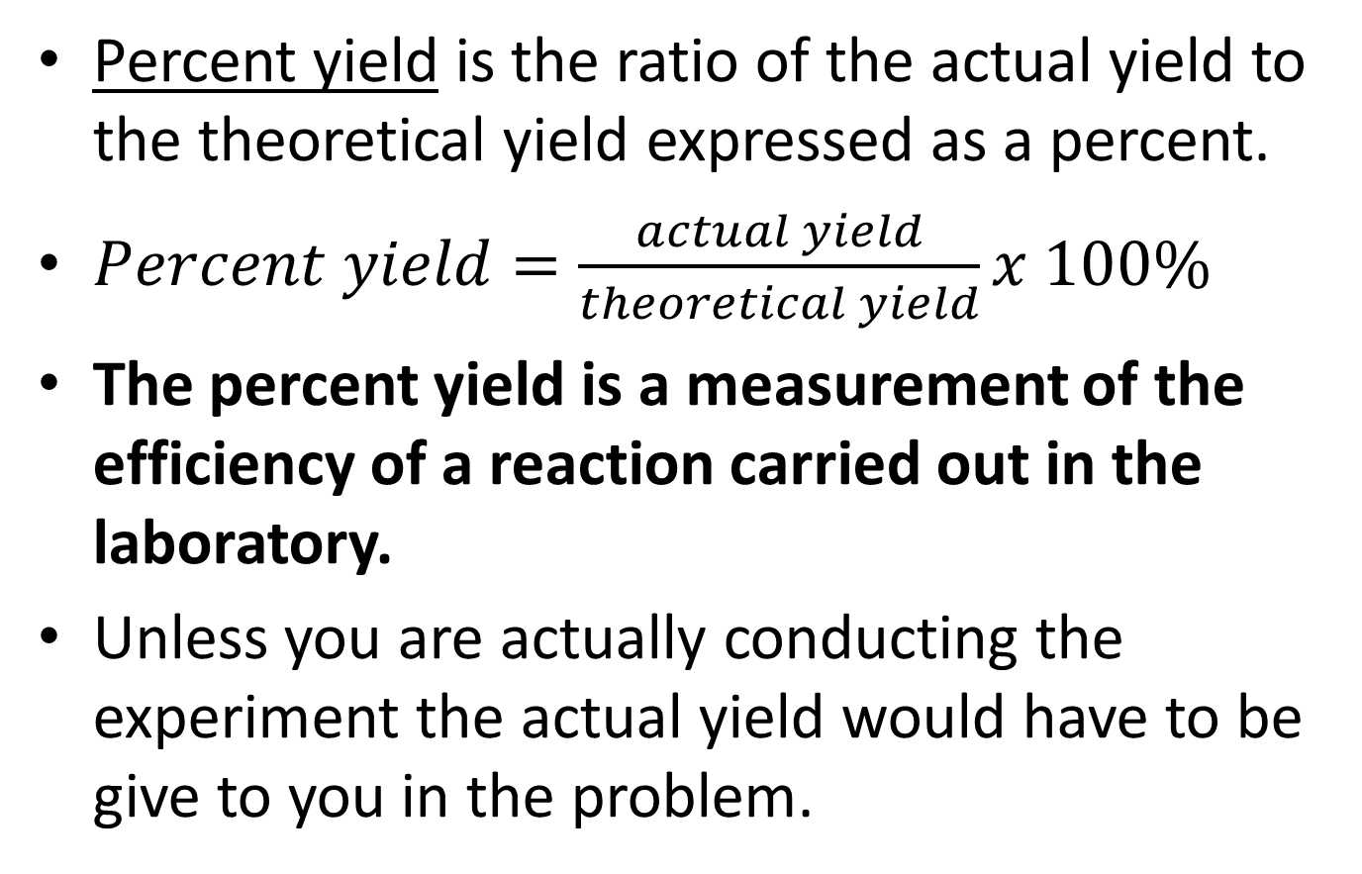
Terminology Part IV
Percent yield is the ratio of the actual yield to the theoretical yield expressed as a percent.
$Percent yield=\frac{actual yield}{theoretical yield}x 100\%$
The percent yield is a measurement of the efficiency of a reaction carried out in the laboratory.
Unless you are actually conducting the experiment the actual yield would have to be give to you in the problem.

Slide 25
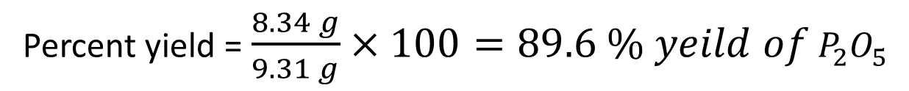
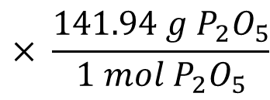
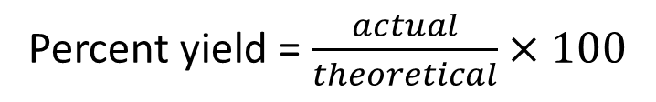




Percent Yield
What is the theoretical yield of P₂O₅ if you have 5.25 g O₂? What is the percent yield if you actually produced 8.34 g P₂O₅? 4P + 5O₂ → 2P₂O₅
Theoretical yield of P₂O₅ is 9.31g
$$×\frac{1 mol{ O}_{2}}{32.00 gO_{2}}$$
$$×\frac{2 mol P_{2}O_{5}}{5 molO_{2}}$$
$$× \frac{141.94 g{ P}_{2}O_{5}}{1 mol{ P}_{2}O_{5}}$$
$$5.25 g O_{2}$$
$$=9.31 g{ P}_{2}O_{5}$$
Percent yield = $\frac{actual}{theoretical}×100$
Percent yield = $\frac{8.34 g}{9.31 g}×100=89.6 \% yeild of{ P}_{2}O_{5}$

Slide 26
Everything combined
2Na₃PO₄ + 3CaCl₂ → Ca₃(PO₄)₂ + 6NaCl
If you have 2.38 g Na₃PO₄ and 6.98 g CaCl₂
determine the limiting reagent
Calculate the theoretical yield of NaCl (you MUST use the limiting as your starting point)
Calculate the mass of excess reagent left after the reaction
If you actually produced 1.56 g NaCl what is the percent yield for this reaction?

Slide 27
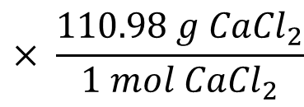
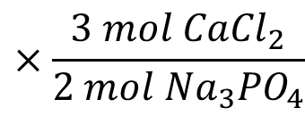
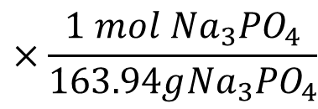


Everything combined
2Na₃PO₄ + 3CaCl₂ → Ca₃(PO₄)₂ + 6NaCl
If you have 2.38 g Na₃PO₄ and 6.98 g CaCl₂
determine the limiting reagent
Turn grams of one reactant into grams of the other
$$×\frac{1 mol{ Na}_{3}{PO}_{4}}{163.94g{Na}_{3}{PO}_{4}}$$
$$×\frac{3 mol{ CaCl}_{2}}{2 mol{ Na}_{3}{PO}_{4}}$$
$$× \frac{110.98 g{ CaCl}_{2}}{1 mol{ CaCl}_{2}}$$
$$2.38 g {Na}_{3}{PO}_{4}$$
$$=2.42 { g CaCl}_{2}$$
We have 6.98 g CaCl₂ and we need 2.42 g CaCl₂ so it is the excess reagent
Na₃PO₄ is the limiting reagent

Slide 28
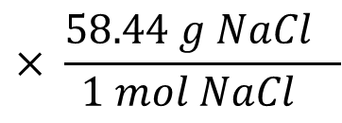
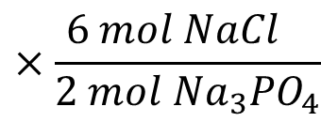
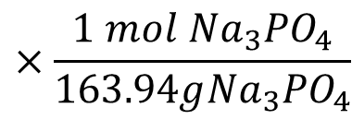


Everything combined
2Na₃PO₄ + 3CaCl₂ → Ca₃(PO₄)₂ + 6NaCl
If you have 2.38 g Na₃PO₄ and 6.98 g CaCl₂
Calculate the theoretical yield of NaCl (you MUST use the limiting as your starting point)
$$×\frac{1 mol{ Na}_{3}{PO}_{4}}{163.94g{Na}_{3}{PO}_{4}}$$
$$×\frac{6 mol{ NaCl}_{}}{2 mol{ Na}_{3}{PO}_{4}}$$
$$× \frac{58.44 g{ NaCl}_{}}{1 mol{ NaCl}_{}}$$
$$2.38 g {Na}_{3}{PO}_{4}$$
$$=2.55 g NaCl$$

Slide 29
Everything combined
2Na₃PO₄ + 3CaCl₂ → Ca₃(PO₄)₂ + 6NaCl
If you have 2.38 g Na₃PO₄ and 6.98 g CaCl₂
Calculate the mass of excess reagent left after the reaction
$$×\frac{1 mol{ Na}_{3}{PO}_{4}}{163.94g{Na}_{3}{PO}_{4}}$$
$$×\frac{3 mol{ CaCl}_{2}}{2 mol{ Na}_{3}{PO}_{4}}$$
$$× \frac{110.98 g{ CaCl}_{2}}{1 mol{ CaCl}_{2}}$$
$$2.38 g {Na}_{3}{PO}_{4}$$
$$=2.42 { g CaCl}_{2}$$
Excess remaining
6.98 CaCl₂ – 2.42 g CaCl₂ = 4.56 g CaCl₂

Slide 30
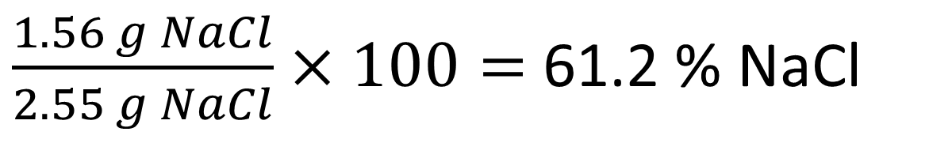
Everything combined
2Na₃PO₄ + 3CaCl₂ → Ca₃(PO₄)₂ + 6NaCl
If you have 2.38 g Na₃PO₄ and 6.98 g CaCl₂
If you actually produced 1.56 g NaCl what is the percent yield for this reaction?
$\frac{1.56 g NaCl}{2.55 g NaCl}×100=$61.2 % NaCl

